Slide 1
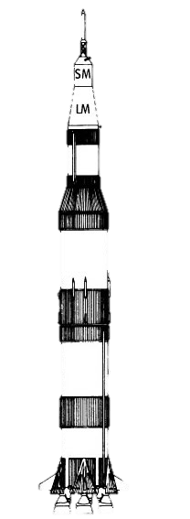


Finance Incentive Program
$5,000.00
BBQ
$8,000.00
Chicken Suit
$15,000.00
Hair Dye
$25,000.00
Tattoo
$30,000.00
Everything
University of New Hampshire
Students for the Exploration and Development of Space

